Slide 1
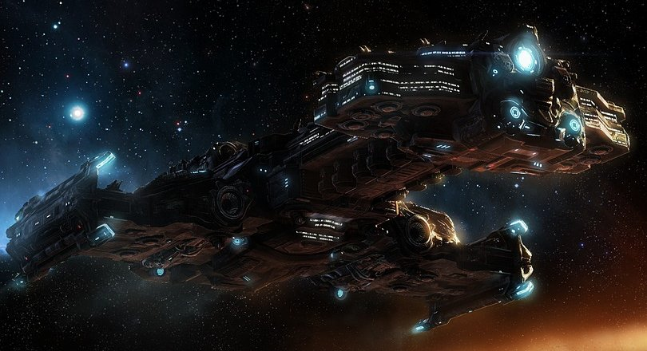
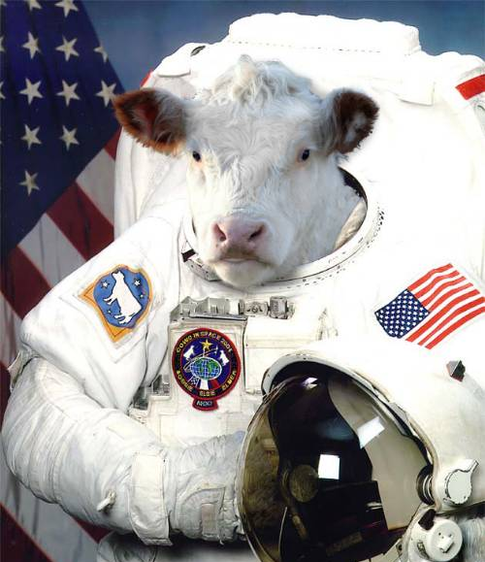
Cattle Bruiser
By: Aedan, Connor, Marcus & Ben

Slide 2
Mission Statement
More strategies → More versatility → Stronger AI
Exploit weaknesses that exist in current popular AI.
Deal with popular rushing tactics → Transition into a strong counter-attack.
Make code that could be useful in many situations.

Slide 3
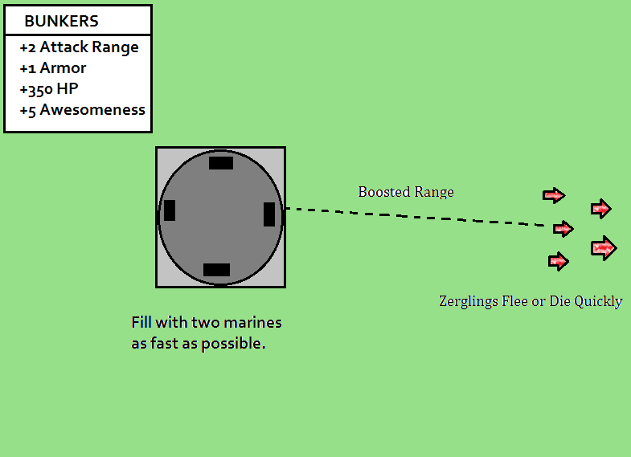
Dealing with WEAKLINGS ZERG
Predictable but deadly, and requiring a solution.
Tested our defense against last years most aggressive 4-pooler; Marvin.
Able to repel rushes successfully on smallest maps.
Bunker code useful in other strategies.

Slide 4

Stimpacks AND YOU
%50 Move/Attack Speed Bonus
Had to monitor several factors:
Are Marines in combat?
Is health too low to be valuable?
Are Stimpacks currently active?
Accounted for Stims in combat simulation.
Results very effective against non-Protoss opponents.
Code could be re-applied to Spidermines or other abilities.

Slide 5
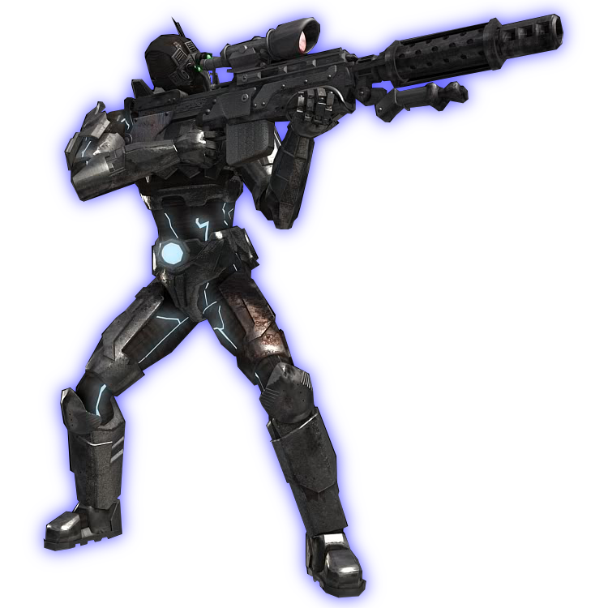
The GO-TO DEFAULT STrat
Needed a strong fall back where more niche strategies did not succeed.
Emphasis on stability.
Tries to stall with Bunkers, then spam out Vultures and Siege Tanks.
Avoids heavy use of Biological units, due to ineffectiveness against Protoss.
Tactics hindered by occasional stalling of build order search.

Slide 6
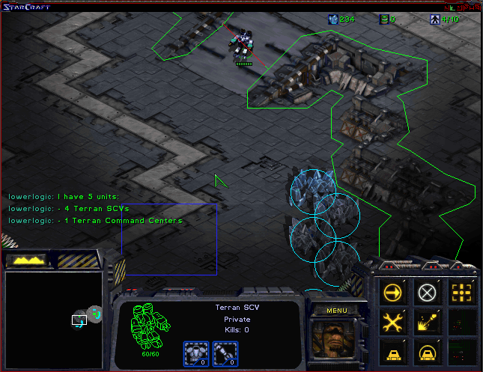
Not Choking on Chokepoints
BWTA chokepoint analysis proved effective, but frequently inaccurate
Chokepoints very valuable strategically, intended to make use of them.
Managed to improve upon the algorithm in Map Tools, now detects chokepoints much more accurately.
Improvements also include, calculating the gap size and difficult the position is to guard based on that.
Applications wide-ranging from a tactics view.

Slide 7
Image Sources
http://img3.wikia.nocookie.net/__cb20100717012436/starcraft/images/d/d9/Hyperion_SC2_DevRend1.jpg
http://img2.wikia.nocookie.net/__cb20080627195642/uncyclopedia/images/c/c0/Space_cow.jpg
http://images.complex.com/complex/image/upload/t_article_image/upqjvng41mp02ndgqlbb.jpg
http://img3.wikia.nocookie.net/__cb20080313020107/starcraft/images/9/98/ResearchStimPack_Terran_SC1.png
http://fc09.deviantart.net/fs70/f/2010/207/3/7/Edited_Terran_Ghost_Render_by_B1x.png
http://hydra-media.cursecdn.com/awesomenauts.gamepedia.com/e/e4/UI_Skillbutton_Commando_Stim.png?version=4213ec27561e4aea94e69ff42df7ddaa

Slide 8
THE END

